Slide 1

Medicine Monitoring System
TEAM MEMBERS
Karan
Mukul
Barath
Shubham
Geetha

Slide 2

TABLE OF CONTENTS
Branch Admin Registration
Medicine Details Registration.
Stock Details Registration
Request/Cancel for Medicine.
Approve Requests

Slide 3
INTRODUCTION
Medicine Monitoring System (MMS) application.
MMS is a system used for managing the supply activities of different medicines to various vendors. It checks the stock updates, sales details and also helps to order medicines.

Slide 4
SCOPE OF THE SYSTEM
Branch Admin Registration – This Module will be used by Branch Admin to register his details in the system. The system stores the details of the Branch Admin in the database.
Medicine Details Registration -- The branch admin have the details of the Medicine to be entered into the system.
Stock Details Registration -- This Module will be used by branch admin to enter the medicines received upon a request approval from admin.
Request/Cancel for Medicine -- The branch admin should be able to request more Medicines to main admin as per the demand and supply of medicine.

Slide 5
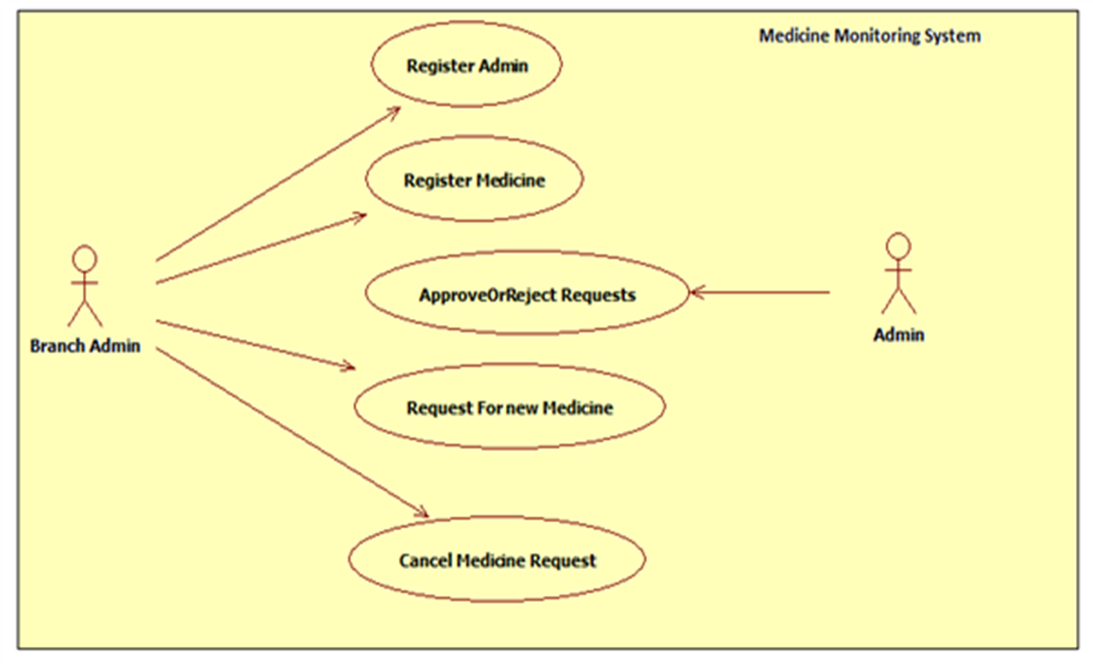
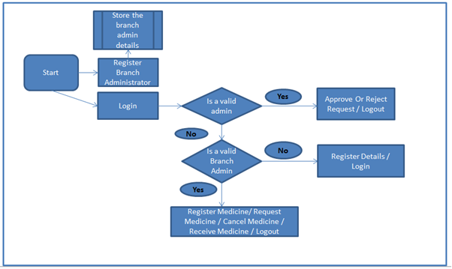
SYSTEM DIAGRAM

Slide 6
DESIGN CONSTRAINTS OF MMS
The Admin registration module and the Medicine registration modules is independent.
Application have a single login feature, Login functionality have the Welcome Page for the application.
Only Main Administrator and registered Branch Administrator can access the application.
Another features can be accessed without login.

Slide 7
PROJECT MODULES
Branch Admin Registration
Medicine Details Registration.
Stock Details Registration
Request/Cancel for Medicine.
Approve Requests

Slide 8
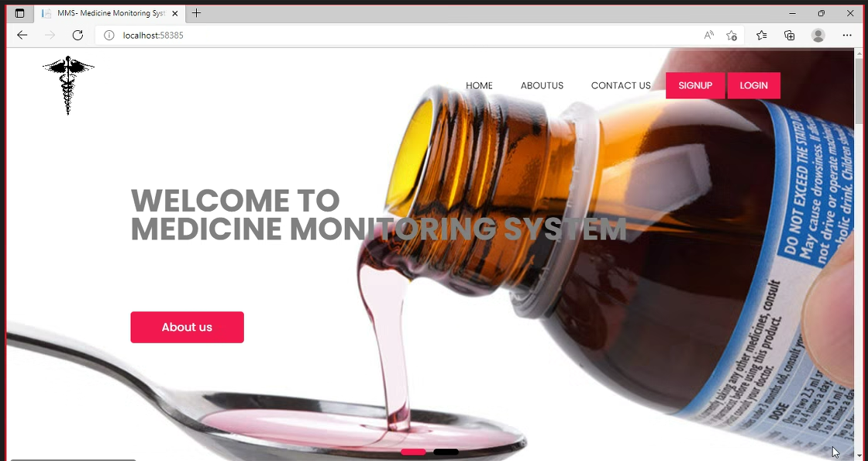




HOME PAGE INTERFACE SignUp , Login AboutUs , ContactUs

Slide 9
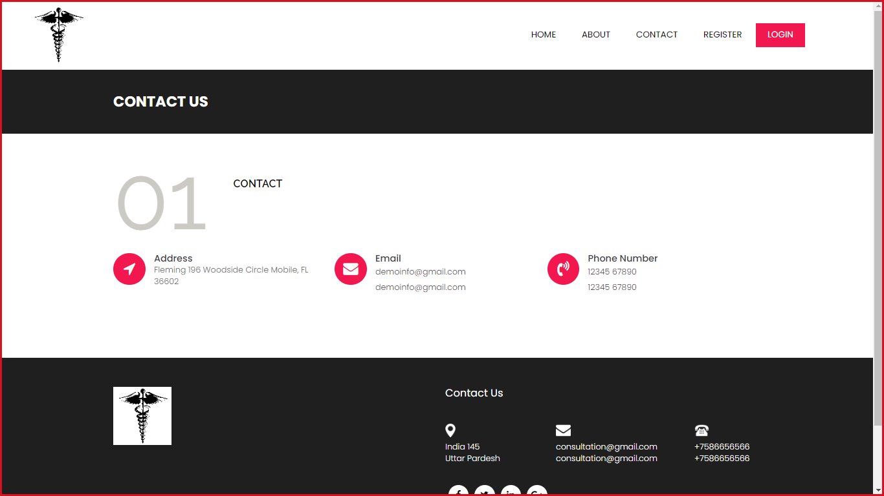
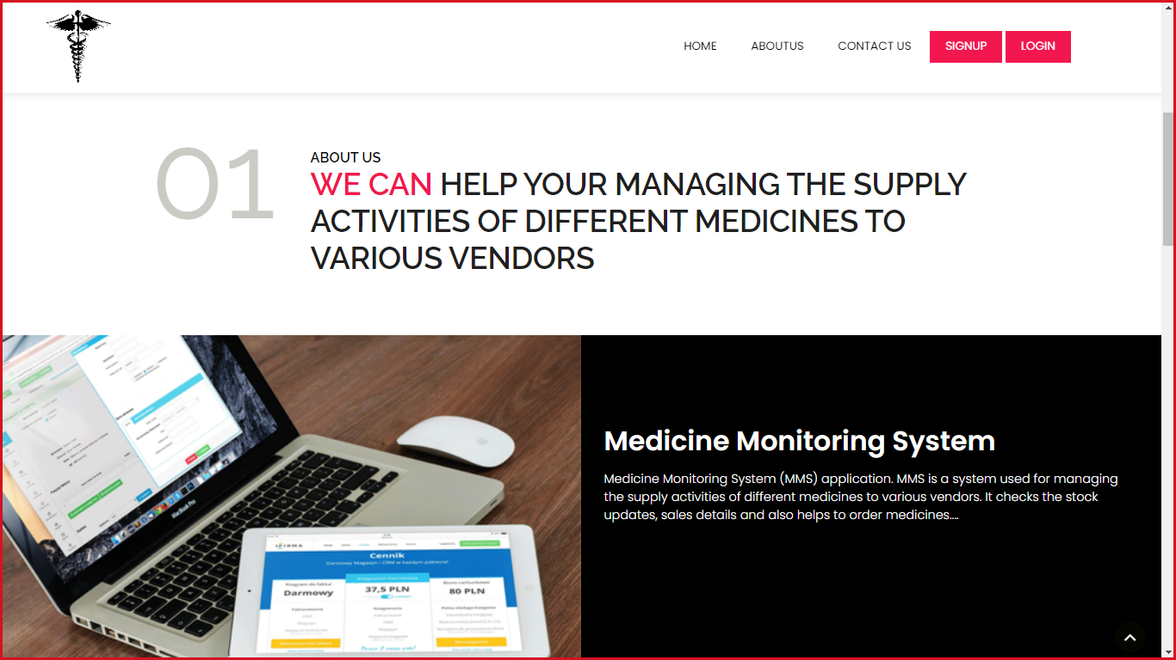
ABOUTUS && CONTACTUS

Slide 10
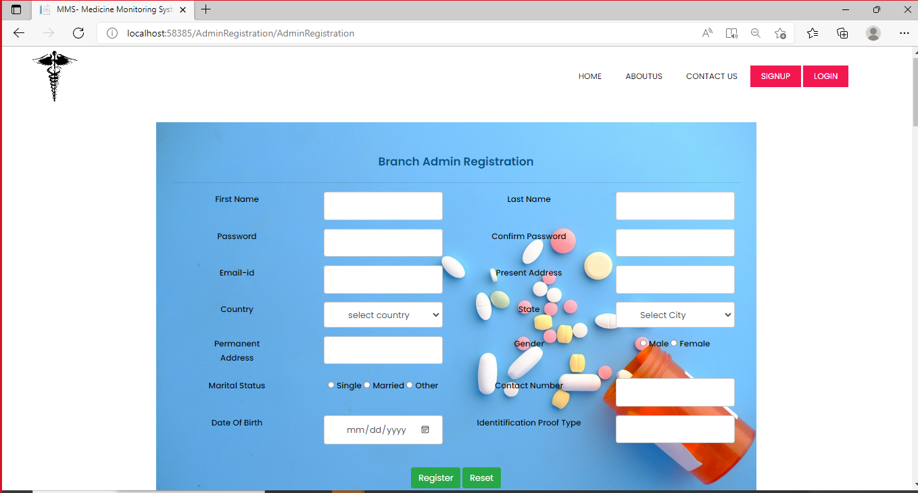
ADMIN REGISTRATION PAGE

Slide 11
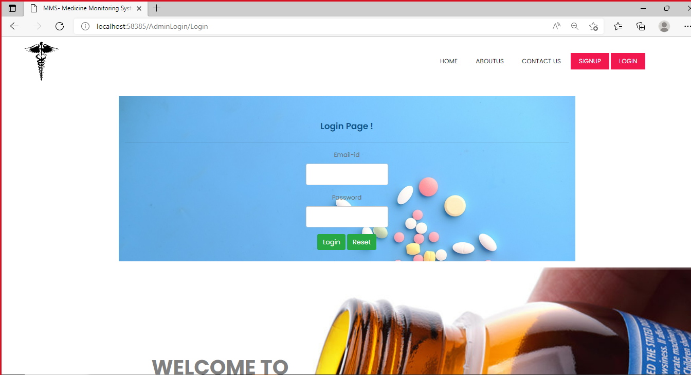
LOGIN PAGE The admin can enter using the login credentials after that it can be redirected to Inbox Page.

Slide 12
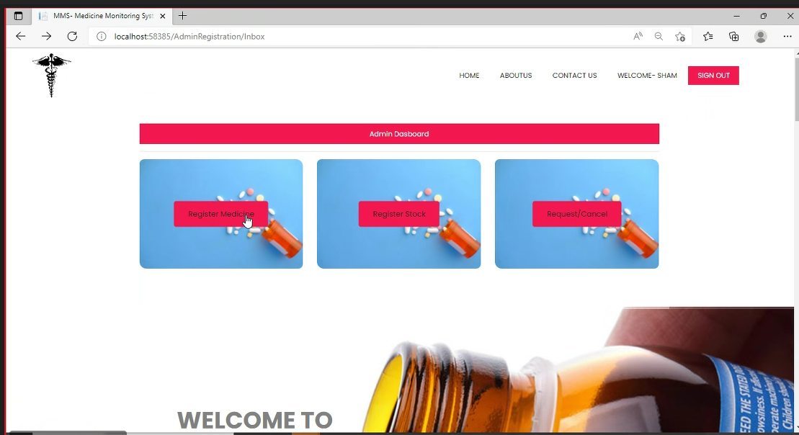
INBOX PAGE INTERFACE Medicine Regitration Stock Registration Request cancel

Slide 13
MEDICINE DETAILS MODULE
This module will be used by branch admin to add the Medicine details into the system. The branch admin have the details of the Medicine to be entered into the system.
Interface requirements - Medicine Registration, Medicine Records
Branch Admin triggers the functionality once he/she receives the details of the Medicines.

Slide 14
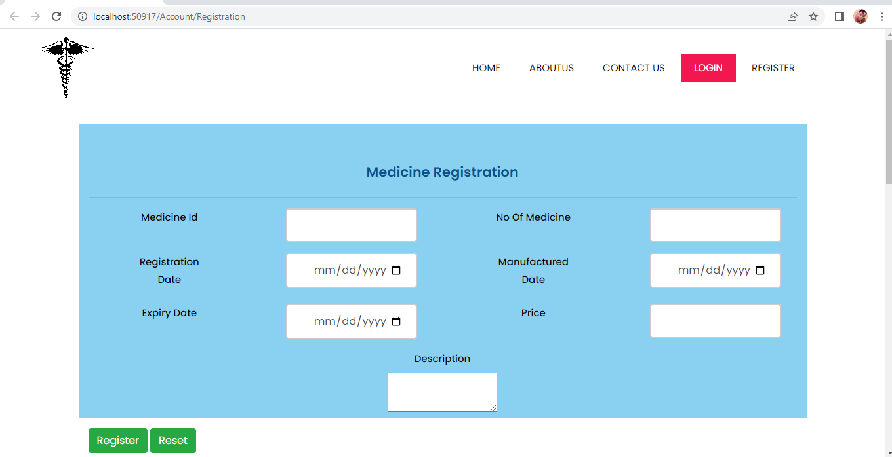
Medicine Registration
This page is used to Register Medicine From the Admin.

Slide 15
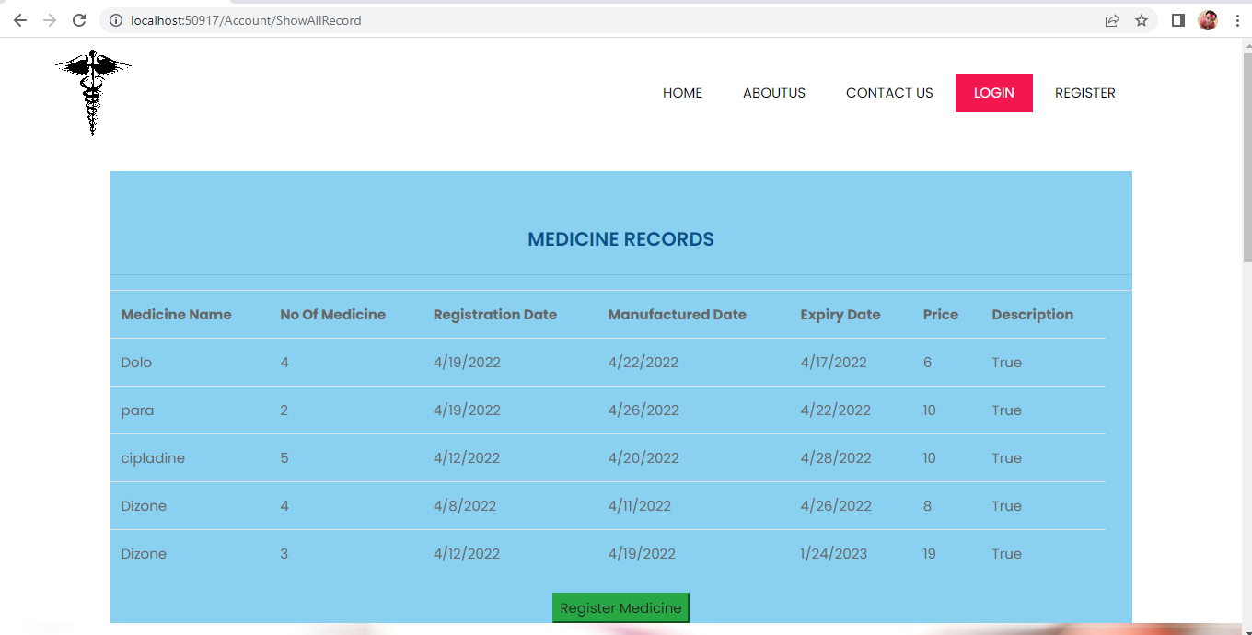
MEDICINE RECORDS This page is used to show records of registered medicine.

Slide 16
STOCK REGISTRATION MODULE
This module used by branch admin is to add/update the stock received from main admin The system stores the details of stock in the system.
Branch admin triggers the functionality once he/she receives the details of the Stocks.
The Branch Admin should have the details of the Stocks to be registered into the system.

Slide 17
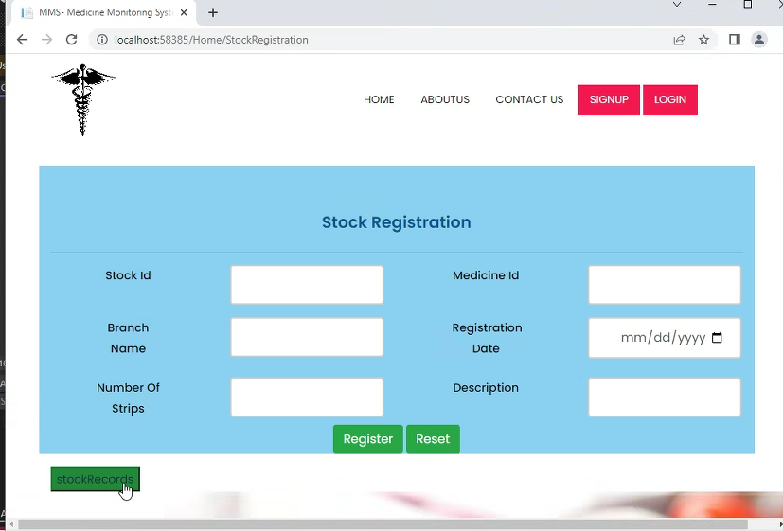
STOCK REGISTER PAGE This page is used to register the stock details as per the medicine records.

Slide 18
REQUEST/CANCEL MODULE
The branch admin is able to request more Medicines to add to the branch’s stock according to the demand.
The branch admin should be able to cancel the request which is in pending status.
Medicines available with the main admin so that branch admins can request for those.
Branch admin should be able to request medicine and can cancel the medicine.

Slide 19
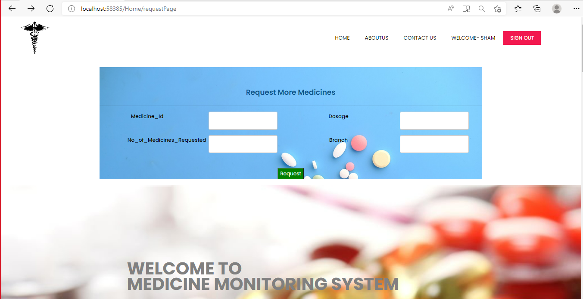
REQUEST PAGE

Slide 20
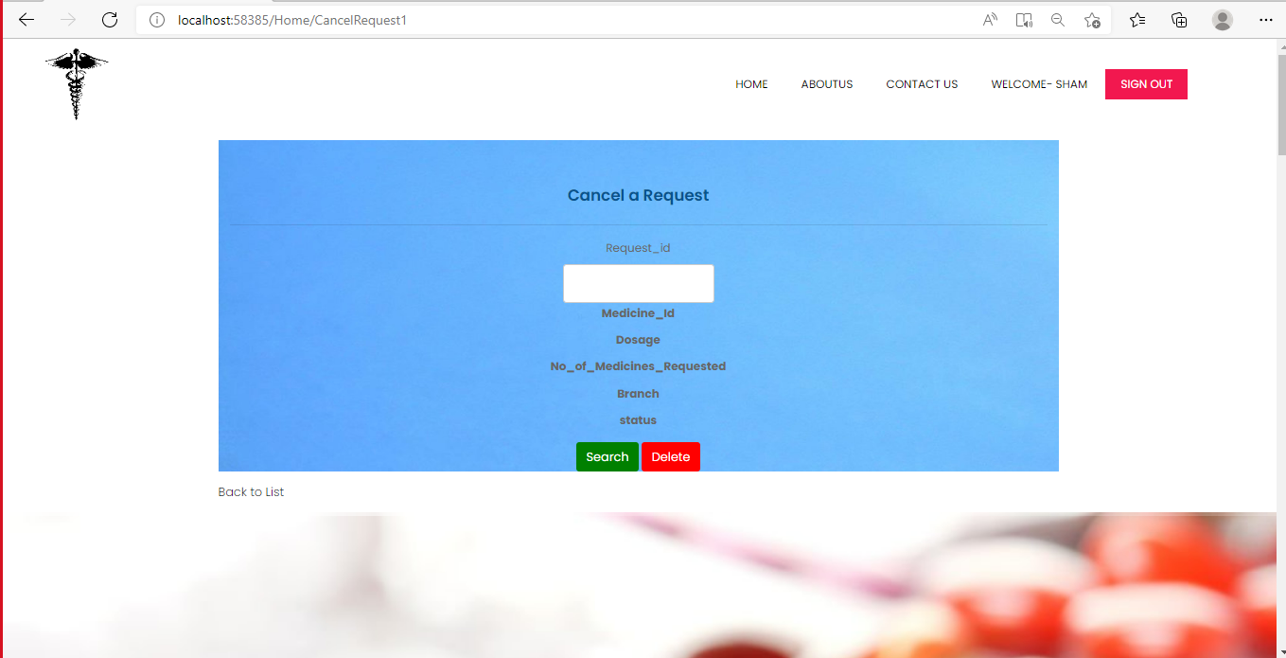
CANCEL PAGE

Slide 21
APPROVE REQUESTS MODULE
The Admin approves or rejects the request for medicines made by the branch admin.
The Admin have an option to view the entire requests irrespective of all statuses or he can choose status. Status values can be Pending/Approved/Rejected.
Once a request is changed to Approved it cannot be further modified.

Slide 22
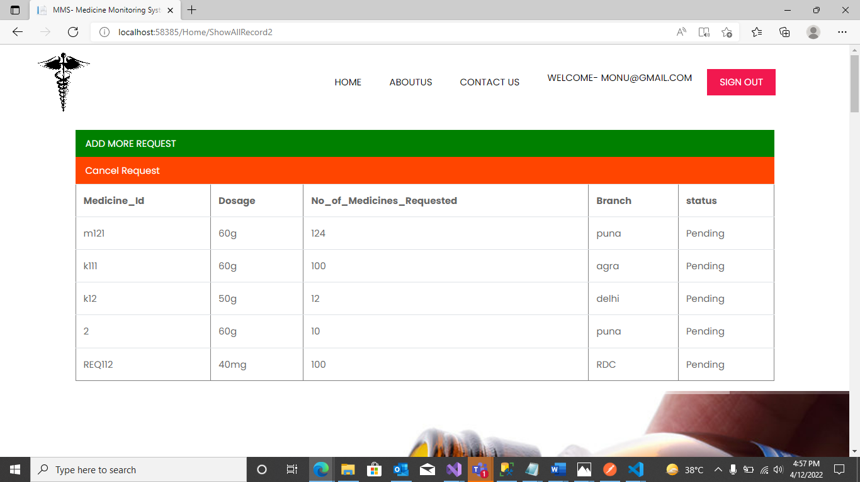
APPROVE REQUEST PAGE The admin can only have permission to approve or reject status.

Slide 23
TECHNOLOGIES USED
ASP.NET MVC
MS-SQL SERVER
HTML
CSS
JAVASCRIPT
BOOTSTRAP
FOR DATABASE CONNECTION – ADO.NET

Slide 24
THANK YOU

